Slide 1
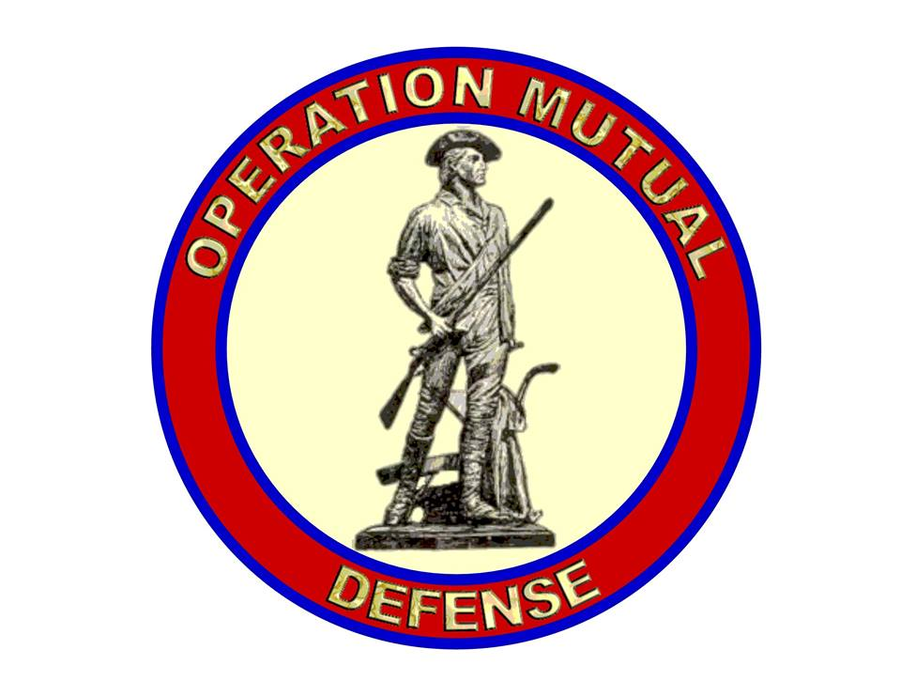
Mission and Organization

Slide 2
Mission Statement
Operation Mutual Defense (OMD) recruits, trains and provides the necessary command and control resources to assist patriots in the defense of lives, individual liberties and property throughout the United States when requested in order to protect them against governmental overreach.

Slide 3
OMD Mission
Who?
A network of Militias that also includes:
Concerned citizens
Local patriots
Journalists, and media relations personnel from patriotic political activism groups
Working in conjunction with local law enforcement if and where applicable
Notes:
Who? A network and coalition of States Militias, patriotic civilians, individual freedom fighters, journalists, and media relations personnel from patriotic political activism groups, in conjunction with local law enforcement if and where applicable.

Slide 4
OMD Mission
What?
Defense of:
Lives
Liberty to exercise God-given rights
Defense of public and private property
At the request of such parties in need of such defense
Notes:
What? Defense of public and private property, lives, and liberty to exercise God-given rights, seen plainly in the laws of Nature, and codified in the Declaration of Independence and Bill of Rights, at the request of such parties in need of such defense, and the documentation and archiving of all defensive actions taken by the coalition for accurate and prompt reporting to all concerned public venues and media.

Slide 5
OMD Mission
Where?
Defensive postures shall be established:
Optimal tactical positions
All laws not in violation of the US or subject State Constitution shall be observed
All laws in violation of the US or subject State Constitution are hereby considered null and void
Notes:
Where? Defensive posture shall be taken up in the optimal tactical position in relation to the people or property in need of such defense. All local laws not in violation of the U.S. and subject States Constitution shall be observed. All laws in violation of the U.S. and subject States Constitution are hereby considered null and void, the enforcement of which most likely represents the need for such defense as herein outlined.

Slide 6
OMD Mission
When?
Upon validation of a local request:
Defensive postures will be taken up in the shortest possible time
Minimum force size to be determined by coalition leadership
Additional resources allocated based on the situation
Notes:
When? As the nature of a Quick Reaction Force is understood, a defensive posture will be taken up in the shortest amount of time possible for the allocation of the necessary defensive resources to the location determined. Minimum force size will be determined by the leadership of the coalition.

Slide 7
OMD Mission
Why?
To protect against governmental overreach
Disregard for the US or subject State Constitution by governmental agents
Unlawful use of force by governmental agents to coerce and/or detain individuals exercising their God given rights
Notes:
Why? As has been the case throughout recorded history, and reasonably assumed throughout unrecorded history, governments instituted amongst men for the protection of private lives and property have always assumed and usurped duties and responsibilities contrary to the purpose of their institution, and, specific to these United States, such governments have done so in complete and utter violation of the documents which established them by the free will of the people, and the union of them via the Constitution and Bill of Rights. Once those governments have ceded their intended purpose to some other end or intent, it can be reasonably and logically ascertained that such entity would become aggressive to its former purpose and the people who established it in pursuit of its own goals. At such a point as the government intends to use the physical power granted it by those who implemented it against them, it then becomes the responsibility of the people themselves to defend their country from its government, and to generally revert to the process outlined by the Declaration of Independence to absolve such government of its power, or separate from it to be freed from its oppression. As this coalition/network is intended for the defense of the populace from enemies foreign and domestic, the latter path shall be left to the determination of that populace, and we shall guarantee them the freedom to make that choice in accordance with man's God-given Liberty, the ideas espoused in the Declaration of Independence, the Constitutions of the several States, the Constitution of their union, and the Bill of Rights, so help us God.

Slide 8
OMD Organizational Structure
OMD is organized in three tiers
Functional Discipline Coordinators (Tier 1)
Discipline Support Personnel (Tier 2)
Volunteers (Tier 3)
Tier 1
Tier 2
Tier 3

Slide 9
OMD Organizational Structure
Advisory Board
Chairman
6 additional board members
Purpose
Provide Discipline, Leadership & interdisciplinary coordination
Determine OMD goals and objectives
Determine OMD participation in response to local requests for assistance

Slide 10
OMD Organizational Structure
Functional Discipline Coordinators
7 currently assigned
Purpose
Provide leadership and daily coordination of a specific functional area
Assist the Advisory Board in determining available resources and supportable level of participation in response to local requests for assistance

Slide 11
OMD Organizational Structure
Current Functional Disciplines
Response Coordinator
Research
Planning
Public Relations
Logistics
Training
Communications

Slide 12
OMD Organizational Structure
Response Coordinator
Primary Advisory Board contact with party requesting defense
Administrative manager of all OMD Missions; assignments and allocations to each event
Militia Liaison
OMD specific assets
OMD volunteers
Maintains communications with requesting party and Militia Liaison conveying reports to the Advisory Board
Notes:
Response Coordinator - Administrative manager of all Operation Mutual Defense Missions, and of OMD specific assets and personnel in an AO, and as an advisor/consultant to the party requesting defense and the volunteers gathered to affect it. Will assign Militia Liaison to each event, maintaining communication and conveying reports to the Board.

Slide 13
OMD Organizational Structure
Research
Primary Advisory Board contact with Tier two researchers
Coordinate OMD research efforts to include:
Develop research strategies to identify and evaluate emerging threats
Conduct strategic risk management assessments
Ensure a balanced research effort between strategic and tactical objectives

Slide 14
OMD Organizational Structure
Planning
Primary Advisory Board contact with Tier two planners
Coordinate OMD strategic planning to include:
Organizational design and control relationships
Development of goals and objectives
Development of strategic decision making processes
Development of a risk management framework

Slide 15
OMD Organizational Structure
Public Relations
Primary Advisory Board contact with Tier two public relations support personnel
Coordinate OMD public relations to include:
Development and dissemination of information
Vetting of media sources and venues
Certification of authorized media outlets
Notes:
Public Relations - Preparation of press releases, consultant on compilation of information to be disseminated. Working with tier 2 members for dissemination of press releases, articles, video and audio authorized productions. Coordinate between tier 2 members regarding: interviews, data collection, etc.; writing necessary documents, including talking points and scripts for audio/visual presentations; dissemination of information,

Slide 16
OMD Organizational Structure
Logistics
Primary Advisory Board contact with Tier two logisticians
Coordinate OMD logistics to include:
Develop standard Table of Equipment as basis for subsequent event evaluation of needs
Development and ongoing analysis of the supply chain
Acquisition and distribution of supplies and equipment during incident response
Notes:
Logistics - Overall coordination of logistical demands for OMD operations, including coordination with BTFA and other cooperating organizations. Once an incident is operational working with tier 2 regional or at large members to arrange for acquisition and distribution of supplies and equipment.

Slide 17
OMD Organizational Structure
Training
Primary Advisory Board contact with Tier two trainers
Coordinate OMD training to include:
Development of training standards and supporting documentation
Establish training site
Recruit and train instructors and evaluators
Recruitment of volunteers to OMD and to OMD training program

Slide 18
OMD Organizational Structure
Communications
Primary Advisory Board contact with Tier two communicators
Coordinate OMD communications to include:
Development of strategic and tactical communications plans
Development of a common equipment list and associated communications protocols & codes

Slide 19
OMD Organizational Structure
Volunteers
Who will receive call out notifications:
Participants on web page discussions
Followers on Facebook
Subscribers to OMD mailing list

