Slide 1

Committees
of
Safety

Slide 2
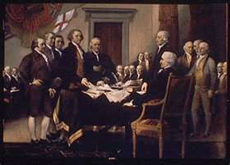
Committees of Safety, Correspondence, and Protection
        What were they?
  They were governments established in the absence of the ability of the existing government to provide for the needs of civilized society
  They were Civil Bodies Politic
  On the voyage from England to America the Pilgrims, with the Mayflower Compact, created a Civil Body Politic
  Jamestown also had a civil body politic

Slide 3
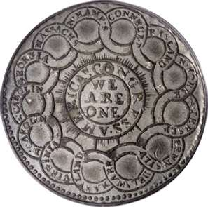
Committees of Safety, Correspondence, and Protection
Over the years, they were known by various names:
  Committee of Correspondence
  Committee of Protection or Inspection
  Committee of Safety
  Associations for, or of _______
Their purpose was always to provide for the needs of civil society - a civil government

Slide 4

What were they?
Committees of Safety existed prior to 1689 and were called by various names
  The Committee which was created in that year in New England is significant in that it was created by the members of the militia
  The colonists were dissatisfied with the government of the Crown headed by Governor Sir Edmund Andros
  Recognizing that the military (militia) authority must always be subordinate to the civil authority, and having serious concern over the abusive authority imposed by Andros, the militia around Boston created their own civil authority in the form of the Committee of Safety
  Representation on the Committee was based upon two delegates being selected by the citizenry to represent each community
  The delegates gathered and exercised their authority by, eventually, imprisoning Governor Andros until he returned to England.

Slide 5
In 1774, the various Committees of Safety called for the First Continental Congress.
  Delegates to that Congress went from town, to county, to Provincial level Committees, before being selected to go to Philadelphia.
In Western Massachusetts, Committees of Safety sent armed militia to force resignation of judges appointed under the Massachusetts Government Act (1774).
Some Committees, such as Worchester County, declared independence from British rule, unless Massachusetts government was returned under the original charter (1774).
On April 12, 1775 (just one week before the Battle of Lexington/Concord), John Hancock, President of the Massachusetts Provincial Congress (later, the Massachusetts Provincial Committee of Safety) requested that all counties, towns and districts form Committees of Safety.

Slide 6
Cambridge April 29, 1775
This may certify that the bearer, Mr. Paul Revere is messenger to the Committee of Safety and that all dispatch and assistance be given him in Instances that the business of the Colony may be facilitated
Jos. Warren, Chair.

Slide 7
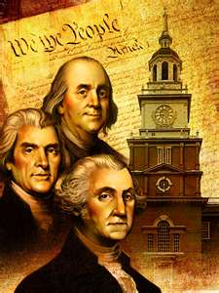
Potential of the Committees
Representation
Unity
Organize and call up Militia
Correspondence with other Committees
Coordination

Slide 8
What if we had a natural or man made disaster that disabled local government and emergency services?
What if our county/city disbands the police dept. like other cities are doing in the U.S? ie: Clarkston Mi, Pontiac Mi, Aztec Nm, and many more…

Slide 9
We need to form and actively create a civil body politic regarding:
    Communications
    Food storage/Water storage
    Command Structure
so that if the time ever arises where the Committee needs to take the reins to protect the community, the plans, means and manpower will already be prepared to do so

Slide 10
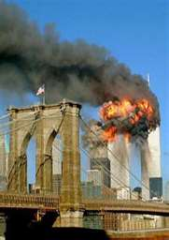
Create and join a Committee of Safety
For your own safety
If you had a flood, hurricane, tornado, or other natural disaster would you want to wait for FEMA?
If crime were to become rampant in your community would you want to rely solely on the police?
If food shortages occurred would you have shared production and storage of food?
If power outages occurred would you have a shared source for food preservation and water wells?
If a foreign Country or the U.N were to invade the United States would you wait for the military to help?

Slide 11
Cultural Challenges
The time to reinstitute neighborhood Committees of Safety and to address issues when existing government ignores them or fails to address them properly, is NOW
As a result of the devolving social, political, and economic conditions, renewed interest in the Committee of Safety concept is spreading across the Union
Those actively elevating the concept into action are facing a serious challenge: At the most basic level of community life — the neighborhood — there exists a culturally-institutionalized level of interaction among modern American neighbors that is arguably the lowest of any in American history

Slide 12
Cultural Challenges
The challenge is even greater because the Great Depression was so long ago and we have not seen war on American soil since 1865…
… It is, therefore, nearly impossible for most Americans to visualize what life would be like if we were under attack in our homes or if store shelves were empty, most businesses were closed and there was no electricity—unless they just close their eyes and think about it…

Slide 13
Take a minute and do so now…

Slide 14
Cultural Challenges
One should feel a significant degree of alarm
At this point we can:
  -Be paralyzed by fear
          OR
  -Begin preparing to survive whatever disruptions our logic and reason determine may come our way in the near future

Slide 15
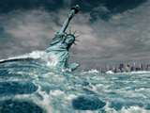
The Coming Storm
There are 310+ million people currently living in America, as our Union experiences the worst economic downturn since 1929
The Union is already experiencing a severe "recession" that will almost inevitably develop into a full-blown "depression." But that is not the “worst case" scenario
There are a myriad of global and domestic indicators strongly suggesting that people should consider preparing to survive a social and/or economic storm of cataclysmic proportions

Slide 16
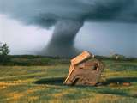
The Coming Storm
If and when we enter a depression (or worse), the trucks could stop running and the lights may go out
At that moment, our own levels of personal preparedness and how well we have organized our neighborhoods will determine the severity of discomfort and inconvenience we will be forced to endure until a state of normalcy returns, no matter how long that might be

Slide 17
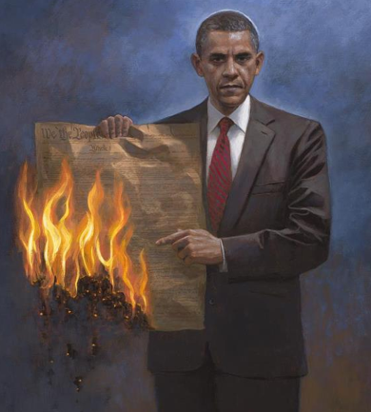
The Coming Storm
At this moment in history, it matters not whether you are certain the government is here to save the world or if you have been studying the global conspiracy since 1947
We all need food, water and shelter — and EACH OTHER — to survive an extended emergency

Slide 18
The Coming Storm
        At this time WE MUST
Summon the common sense of cavemen and the colonists
Become acquainted with our neighbors and initiate meetings with them to discuss how we will organize…
    -As individual households
    -As inter-dependent communities
  ... if the trucks stop running and the lights go out

Slide 19
We need prominent figures and community leaders to be involved in Committees of Safety.
Elders and Seniors with life and worldly wisdom
Your experience is greatly needed in your community
Veterans of Foreign Wars (VFW), Disabled American Veterans (DAV), and American Legion have already served their country
They were willing to give their all so that their posterity could enjoy the fruits of this great nation, as you should also
They have served, with honor, and now they are retired from that service…but those who can will do it again if needed
NOW IT’S YOUR TURN

Slide 20
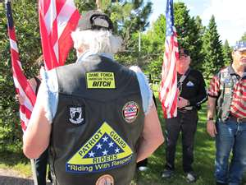
Many soldiers that had fought side by side with the British against the French and Indians chose to continue service to their communities as members of the Committees of Safety

Slide 21
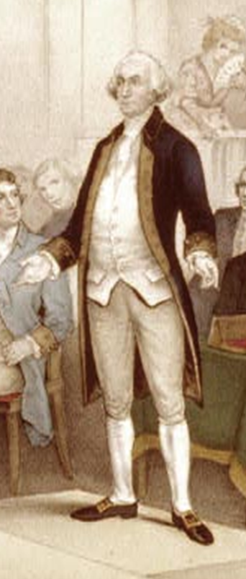
General George Washington led the Continental Army to victory
He was later recalled to serve as President of the Constitutional Convention
He then returned to spend his time under his own "fig tree and vine”
He was called, once again, to serve as the first President of the United States
He served when his country called him to serve and retired from military service when he was no longer able to serve in such capacity
He served twice more in civil capacity because he was needed

Slide 22
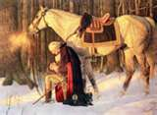
Do veterans have any less obligation to continue to serve that which they once served so proudly?
Can they find another way to serve so that their posterity will enjoy the fruits of this great nation?
Have we learned all we need to from our Elders?
Being past the age and physical condition required for military service should veterans serve as members of a Committee of Safety?
If the country needs them, as it did George Washington, can we withhold such service when the need is so great?

Slide 23
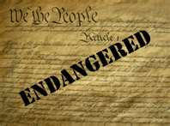
Their service, then,
was for our now
Our service now
is for those who are to follow
Join a Committee of Safety
Your service and experience
IS NEEDED

Slide 24

Some things Never Change
It is appropriate to end this presentation by revisiting the Founding era to show that, while times and technology may have changed over the last 250 years, the responsibility of government to the people has not

Slide 25
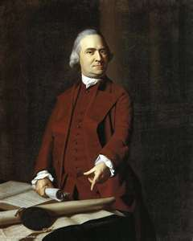
“If ever a time should come when vain and aspiring men shall possess the highest seats in government, our country will be in need of its experienced patriots to prevent its ruin.”
Samuel Adams, in a letter to John Adams (4 October 1790)

Slide 26
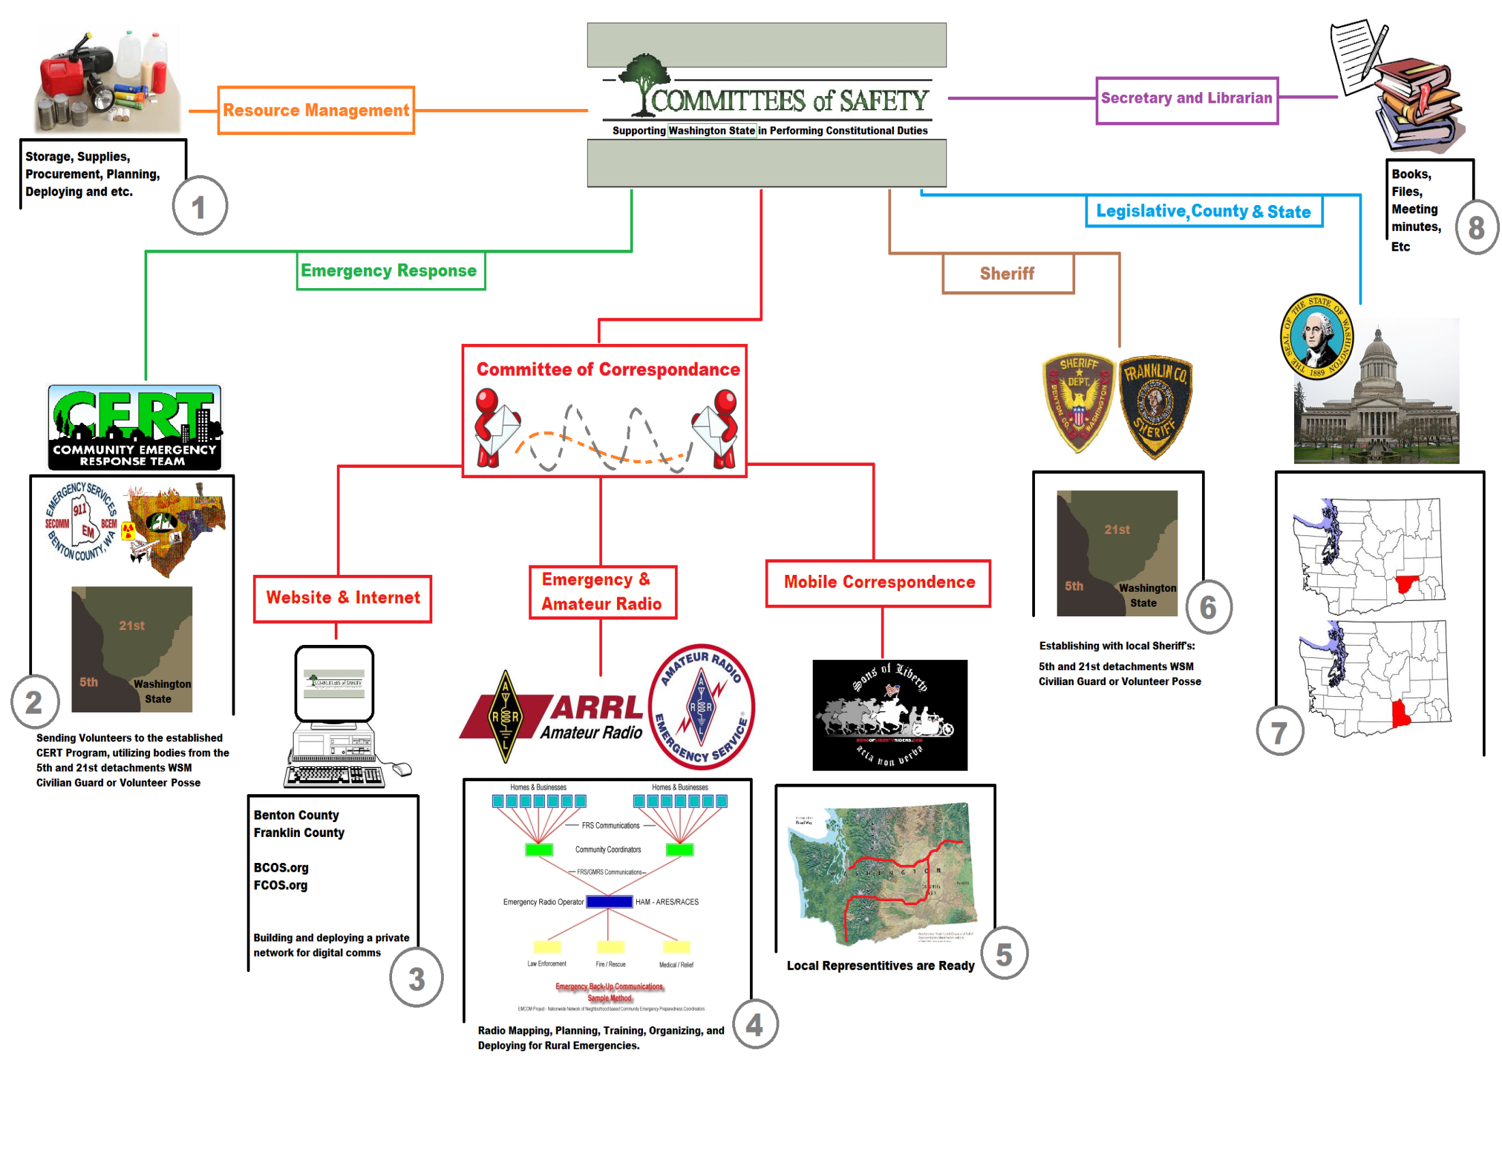
SAMPLE

Slide 27


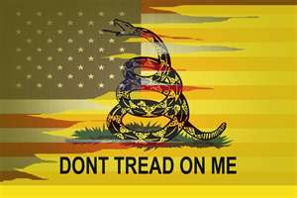
The Boston Liberty Tree
In Provincial Congress,
Concord, April 12, 1775.
WHEREAS the Preservation of our Country from Slavery, depends under God, on an effectual Execution of the Continental and Provincial Measures for that Purpose:
RESOLVED, That there be now appointed for each County in this Colony, a Committee consisting of Five Persons, any Three of whom to be a Quorum, whose Business it shall be, to receive from the Committees of Correspondence in their respective Counties, a State of the Conduct of the Towns and Districts, with Respect to their having executed the Continental and Provincial Plans as aforesaid ; and it shall be the Duty of said Committees to meet on the first Wednesdays of May, July, September, November, January and March, and prepare a Report of the same, to be laid before the Congress at it's then next Session, that any Neglect of such Towns and Districts in executing such Plans, may be speedily and effectually remedied.
Also, RESOLVED, That it be, and it is hereby strongly recommended, to the Committees of Correspondence in the several Towns and Districts in this Colony, some Time before the first Wednesday in May, July, September, November, January and March aforesaid, to render to any one of the Members of their County Committees aforesaid, a true State of the Conduct of their respective Towns and Districts, with Respect to their having executed each Plan recommended by the Continental and Provincial Congresses ; and to use their utmost Diligence for this important Purpose.
And whereas some Towns and Districts in the Colony, may be destitute of so excellent an Institution as Committees of Correspondence :
RESOLVED, That it be, and it hereby is strongly recommended to such Towns and Districts, forthwith to choose them, and to afford them Assistance at all Times, in effectually suppressing the Efforts of the Enemies of America, whenever they shall make them.
Signed by Order of the Provincial Congress,
John Hancock , President.

